Slide 1
Revolutionizing the management: The student management system
Team members:
Bigyan Shrestha
Dinesh Bajagain
Prajal Bhattarai
Sandesh Khadka

Slide 2

Map of the showcase
Introduction
Problem statement
Solution overview
Feature and functionality
System Requirements
Technical details
Future enhancements
User benefits
Conclusion
Snapshots
References
Limitations

Slide 3

Introduction
Welcome to our revolutionary student management system, designed to transform the way educational institutions manage student data. Our cutting-edge technology streamlines the entire process, from enrolment to graduation, making it easier than ever before. With our system, you can say goodbye to the days of sifting through endless paperwork and manually entering data into spreadsheets. Our intuitive interface allows for easy navigation and data entry, freeing up valuable time for educators to focus on what really matters - their students.

Slide 4





Problem statement
Educational institutions face numerous challenges when it comes to manage student data manually like:
1.high chance of data damage
2.Time consuming while searching
3.mistakes increases mess in the record
4.limited storage

Slide 5

Solution overview
Our student management system is the answer to the growing need of the effective, efficient and reliable student data management.
Our system offers a range of benefits including easy access to student, security, navigation and so on. With our system, educational institutions can
Save time.
Reduce efforts.
Improve efficiency.

Slide 6

Feature and functionality
The student management system offers a wide range of features that makes easy to manage student data. The software shows a menu bar from where they can select the required services like:
Adding the new students' data
Appending the data
Deleting the data
Displaying specified or all students' data

Slide 7
System Requirement
1.Hardware:
PC with Pentium II Processor (260 MHz) or latest
32 MB of RAM or more
Hard disk with at least 50 MB of free space
2.Software:
OS Windows ( Windows XP, Windows 7, Windows 8, Windows 10)

Slide 8

Technical details
The student management system is built on the concept of structure , file handling that ensures security and reliability. The system is designed to handle large volume of data with ease, while ensuring that the data can be accessed easily at the time of need.

Slide 9
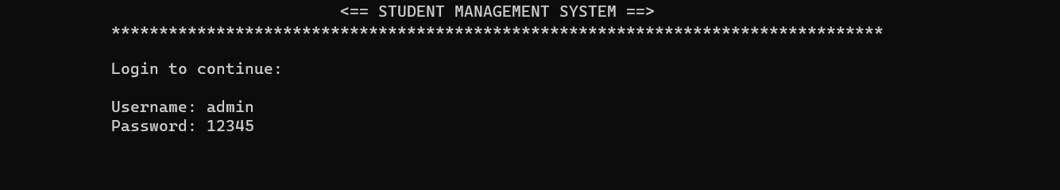

Snapshots:
Login:

Slide 10
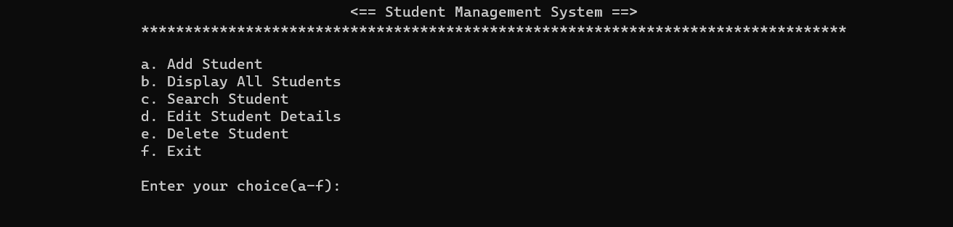
Menu Page:

Slide 11
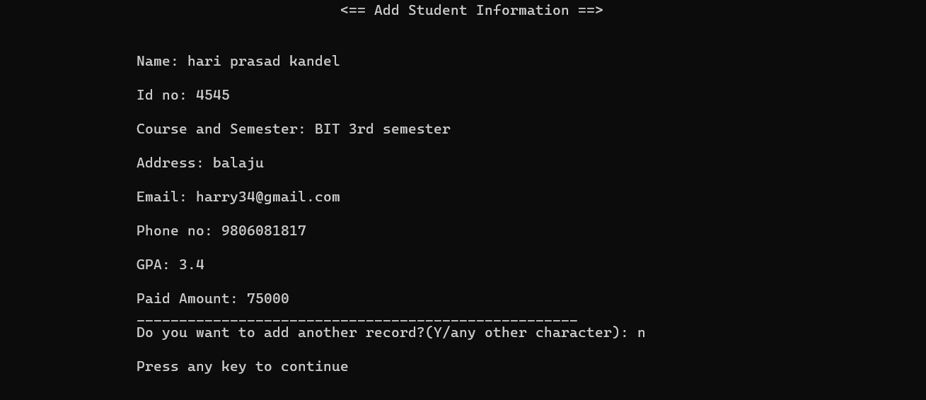
Add student:

Slide 12
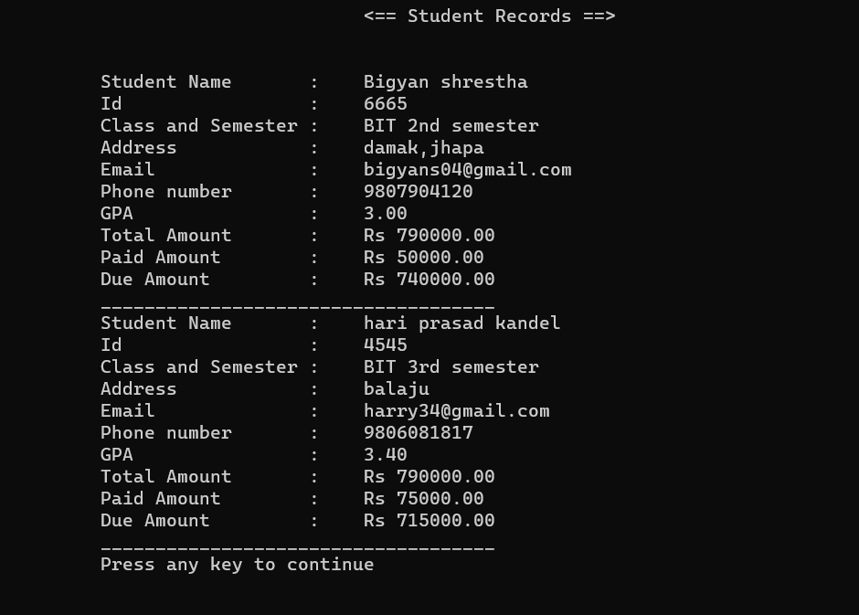
Display student:

Slide 13
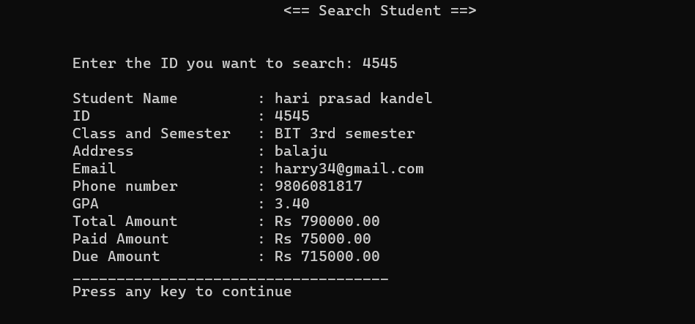
Search student:

Slide 14
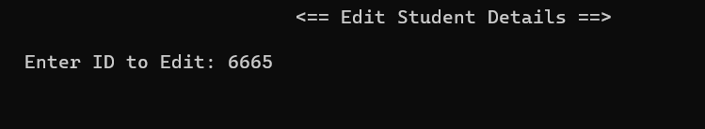
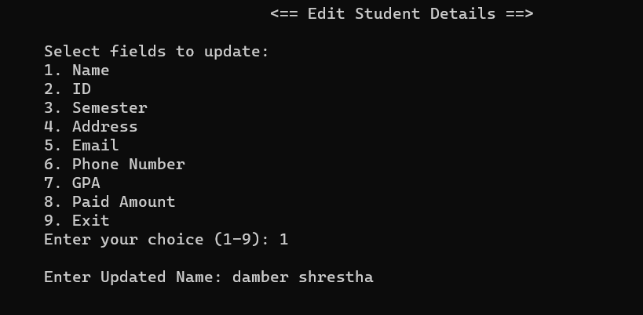
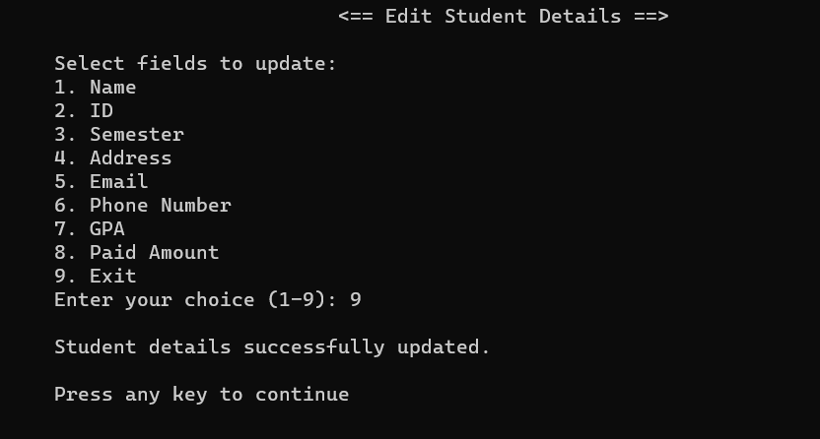
Edit student:

Slide 15

Delete student:

Slide 16
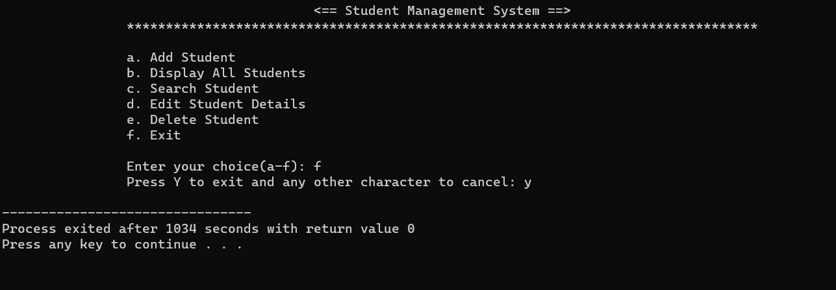
Exit:

Slide 17

Future enhancements
We are looking further on improving the following aspects and features of the software in the future :
user-interface and graphics.
Automatic report generation.
Keeping track of attendance and so on.

Slide 18

Limitations
Due to the lack of proper functionality in c language , this project could not reach its full potential and has left some limitations like :
No connection to the cloud storage.
Monotonous user interface.

Slide 19




User benefits
1.Easy navigation
2.Saves time
3.Data security
4.Performance tracking

Slide 20

Conclusion
The student management system is a powerful tool that can help educational institutions manage their student data more efficiently and effectively. With the concept of file handling, powerful security, data storage capacity and easy navigation, the system has the potential to transform student data management.

Slide 21
References
Open AI. “ChatGPT.” Chat.openai.com, Open AI, 30 Nov. 2022, chat.openai.com/. Accessed 2 July 2023.
Open AI. “ChatGPT.” Chat.openai.com, Open AI, 30 Nov. 2022, chat.openai.com/. Accessed 24 July 2023.
Roberts, Bucky. “Thenewboston - YouTube.” Www.youtube.com, Bucky Roberts April. 2011, youtube.com/user/thenewboston. Accessed 28 July 2023.
Jain, Sandeep. “GeeksforGeeks | a Computer Science Portal for Geeks.” GeeksforGeeks, Sandeep Jain, 27 Mar. 2023, geeksforgeeks.org. Accessed 3 Aug. 2023.
Help and guidance from project instructor and coordinator Mr. Deepak Khadka.

